Slide 1
COMSATS RESTAURANT
A RESTAURANT BILLING SYSTEM

Slide 2
01
WELCOME SCREEN AND FOOD MENU
02
ORDER MENU
03
INPUT AND OUTPUT CONVERSIONS
CODE BREAKDOWN
04
RECIEPT

Slide 3
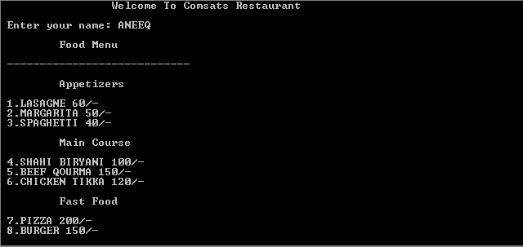
WELCOME SCREEN

Slide 4
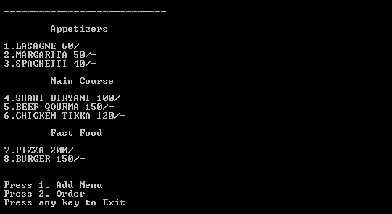
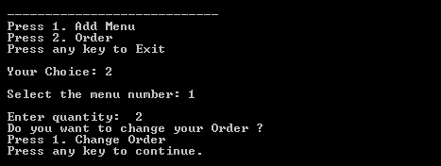
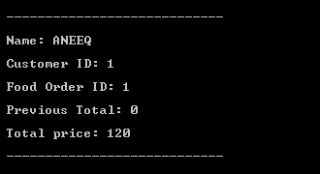
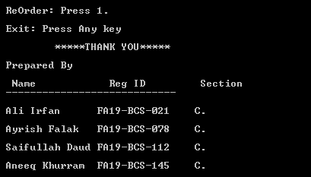
ORDER MENU
INPUT
RECIEPT

Slide 5
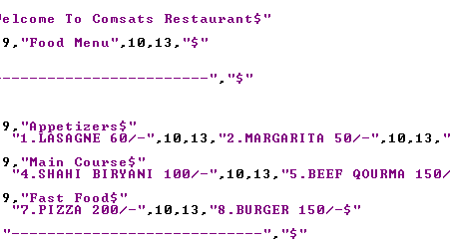
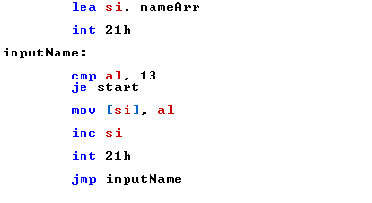
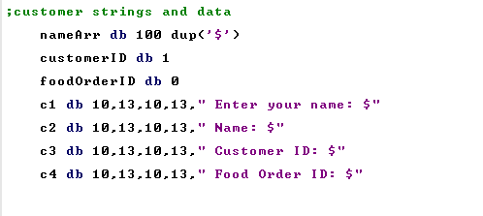
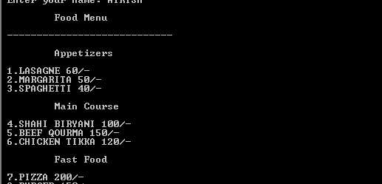

Slide 6
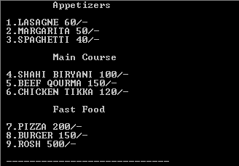
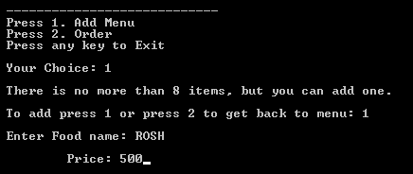

Slide 7
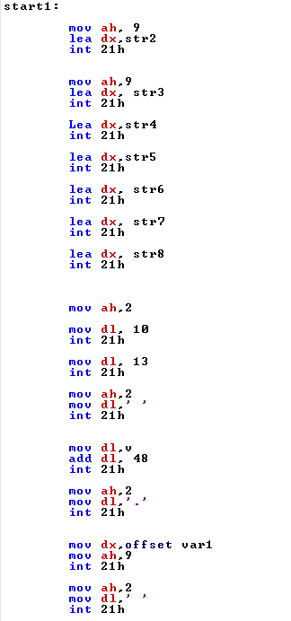
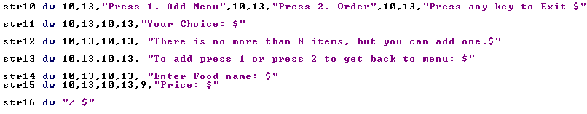
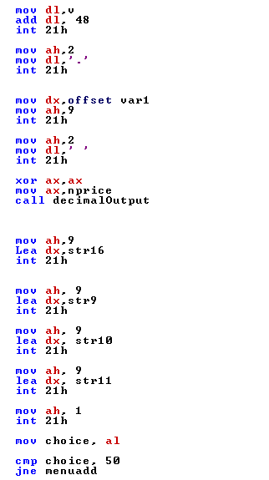
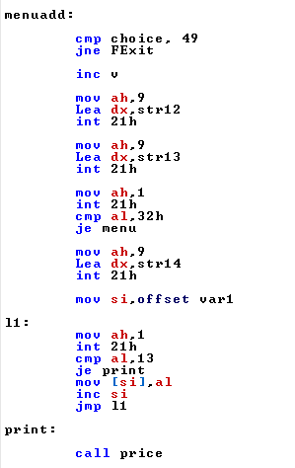

Slide 8
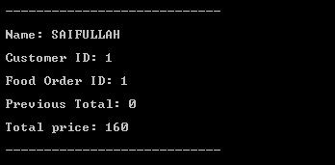

Slide 9
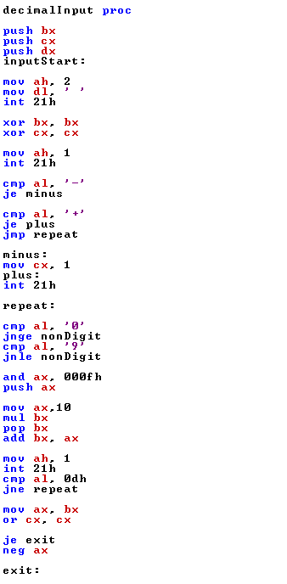
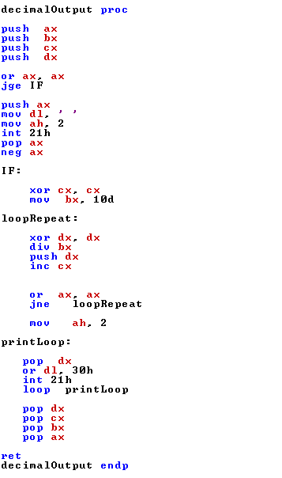

Slide 10
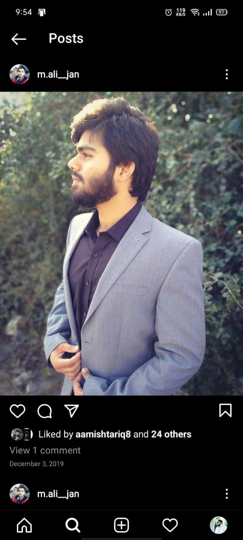
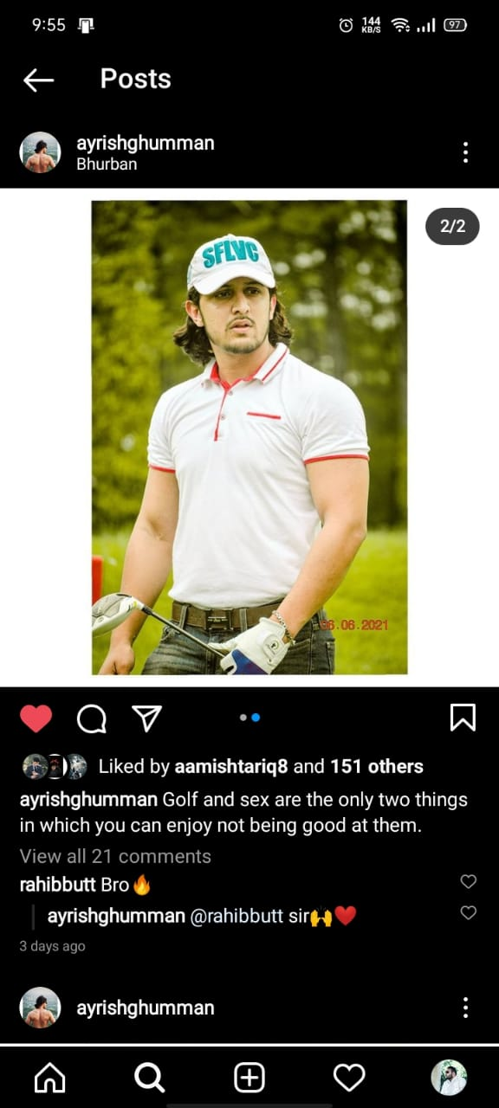


Our Team
M. ALI IRFAN
AYRISH FALAK GHUMAN
SAIFULLAH DAUD KHAN
ANEEQ KHURRAM
MASTER CHEF
FA19-BCS-021
MASTER CHEF
FA19-BCS-078
MASTER CHEF
FA19-BCS-112
MASTER CHEF
FA19-BCS-145

